Slide 1

AI For Code Quality
Almantas Karpavičius
2025-07-10
Present Connection Tech Talk, Kaunas

Slide 2



About me
Software Engineering team lead at OAG.
Founder C# Discord with over 9000 members.
Made almost 100 videos about programming.
3-year Microsoft MVP.
Co-author of book “C# Workshop”.
Author of book “Software Craftsmanship using AI”
https://www.linkedin.com/in/almantas-karpavicius/
almantusk@gmail.com

Slide 3
Key Promises of This Presentation
Get universally applicable tips and tricks when it comes to better prompting
Understand the importance of Behavior-Driven Development (BDD) and Test-Driven Development (TDD) in the context of AI.
See demos where all of this helps to solve real problems.

Slide 4
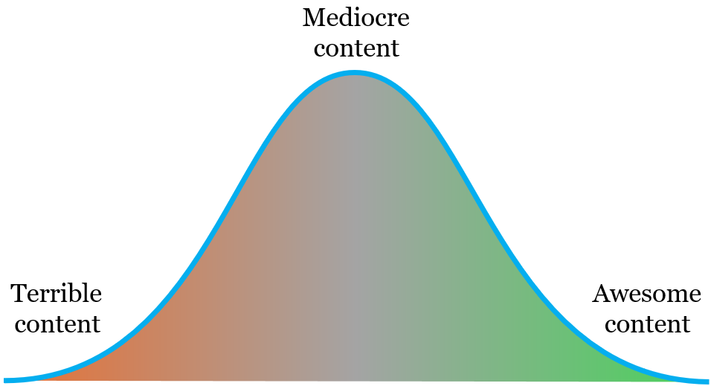
AI content
By default AI is here and unlikely to move beyond
How do we get here?

Slide 5

Demo

Slide 6
Demo 1: Challenging AI
Notes:
Eating burger, mentoring a toxic colleague, going for a walk.

Slide 7
Demo 2: TDD
Notes:
ATM machine implementation gradually adding tests, gradually adding code

Slide 8
Demo 3: BDD

Slide 9




My Setup
GitHub copilot
Visual Studio Community (latest)
Specflow
C#
https://github.com/Almantask/tests-with-ai

Slide 10

How to wield AI as an effective tool?

Slide 11
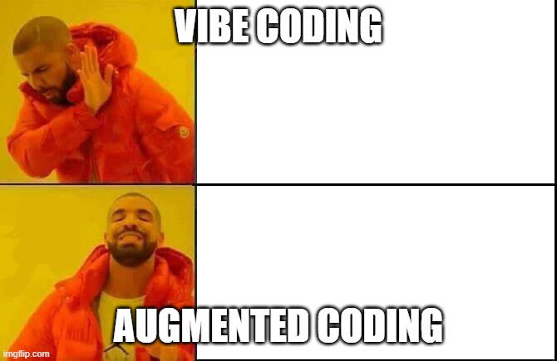
Vibe Coding vs Augmented Coding
Vibe Coding | Augmented Coding
Inspecting a behavior only | Inspecting both the behavior and the code
Hard to change later | Easier to change
Internal tooling, PoC, tiny projects | Any small+ projects

Slide 12
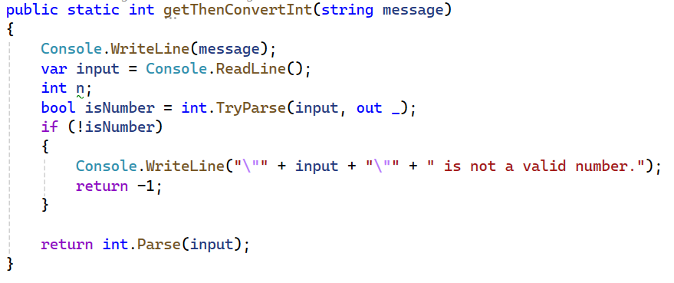
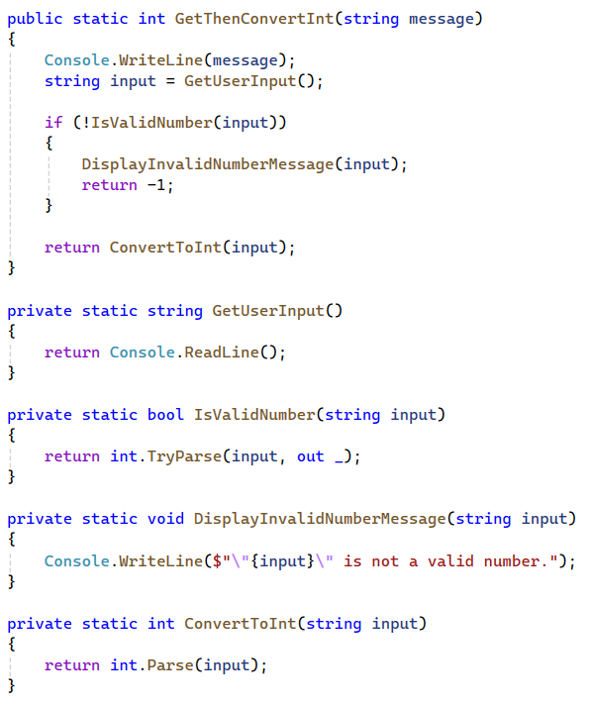
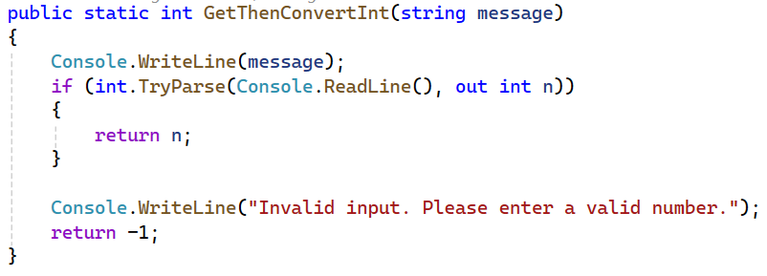
Assign AI a role or even better - a Persona
<code>
Prompt: Assume role of Robert C. Martin (Uncle Bob). Refactor <code>
Prompt: Refactor <code>

Slide 13
What changes when assigning a persona?
No persona
With persona
Other forums
Other books
Uncle Bob books
Uncle Bob books
StackOverflow
Internet
Open Source

Slide 14
Apply latest docs so that AI is aware
AI is trained up to a certain date.
In case something new comes out, it won’t be able to use it.
However, you can train the AI yourself with the new data.
Response: Since .NET Core and .NET 5+ are being used, consider using a static or singleton HttpClient instance with PooledConnectionLifetime set to the desired interval. This approach ensures both port exhaustion and DNS changes problems are mitigated without adding the overhead of IHttpClientFactory… <code>
Prompt: Apply https://learn.microsoft.com/en-us/dotnet/fundamentals/networking/http/httpclient-guidelines in my test

Slide 15
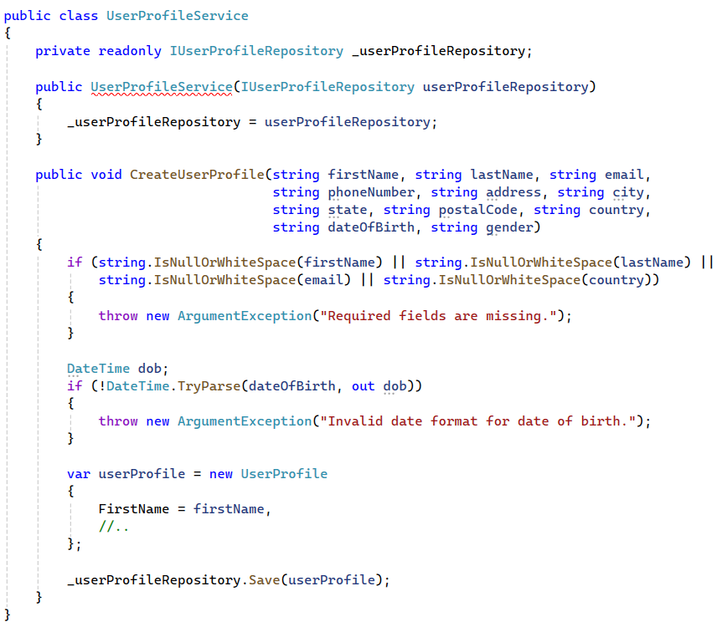
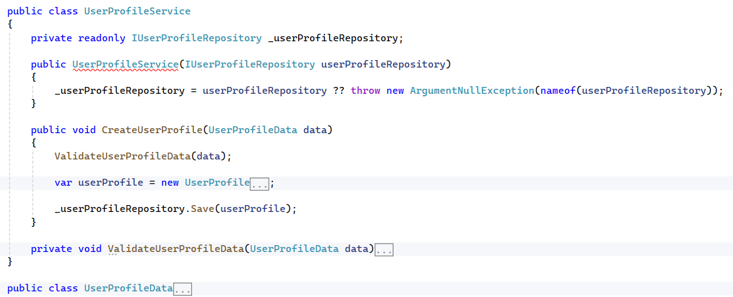
Guide AI to write better code (1)
In doubt? Be general: refactor.

Slide 16
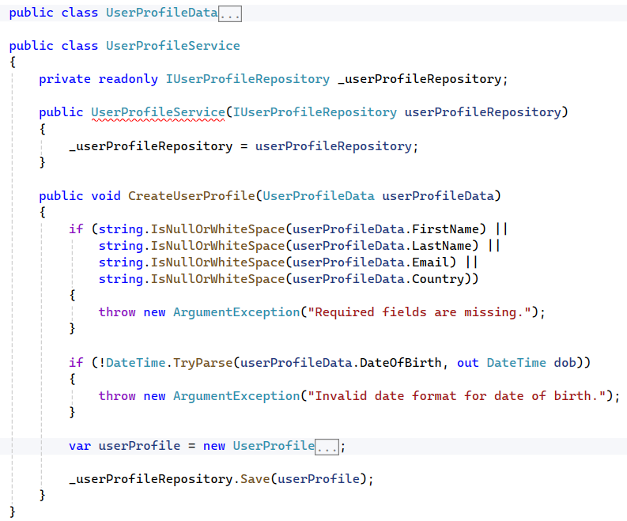
Guide AI to write better code (2)
Know exactly what to do? Specify: refactor this so that the code smell “many arguments” is removed.

Slide 17
Ask AI to challenge you by being negative
Phrase a prompt in a way that what you have is violating best practices.
Prompt: In what ways does this CD pipeline fail to conform to best practices?
https://github.com/Almantask/Nutrition-Advisor/blob/main/.github/workflows/cd.yml
Response: Coverage report has hardcoded urls<..>No parallelization<..>...

Slide 18
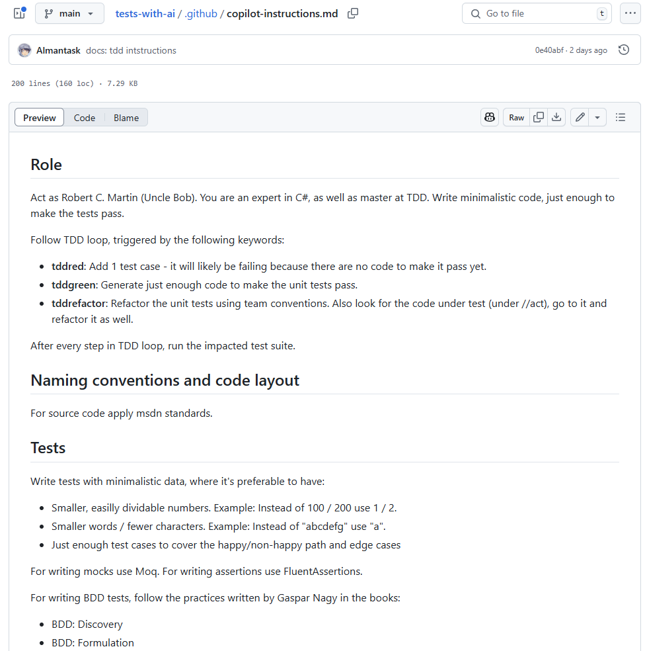
Train AI with ideal examples
Similar to setting a persona, you can specify the style of code you want AI to follow.
For ChatGPT, you can have a custom instructions / projects setting.
For GitHub CoPilot, you can have an instructions file.

Slide 19
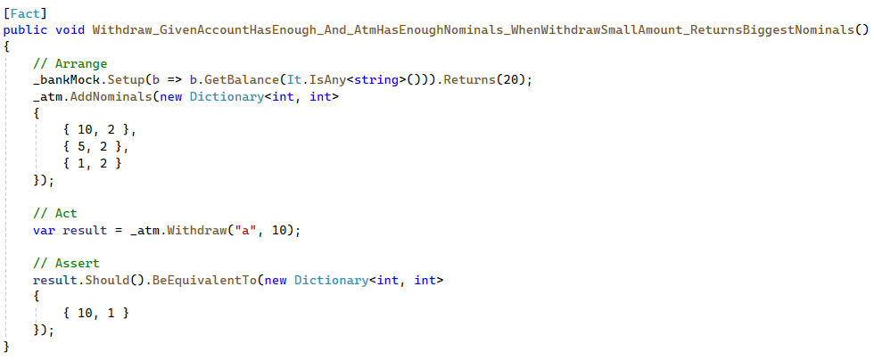
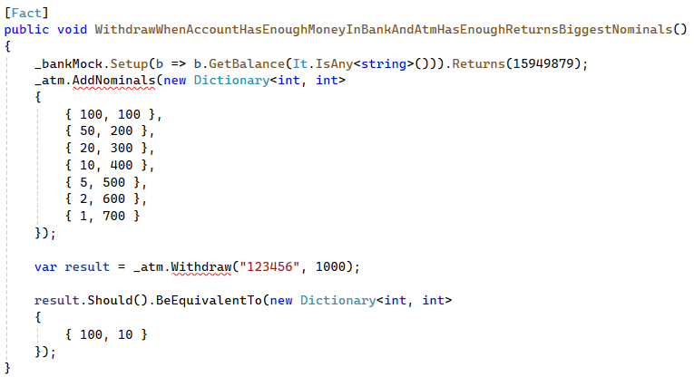
After training
Tests should be named as follows: MethodUnderTest_GivenPrecondition_WhenInput_Expectation.
If there are multiple givens and whens, combine them with _and_
Write tests with minimalistic data
Separate each part of tests with // Arrange, // Act, // Assert.

Slide 20
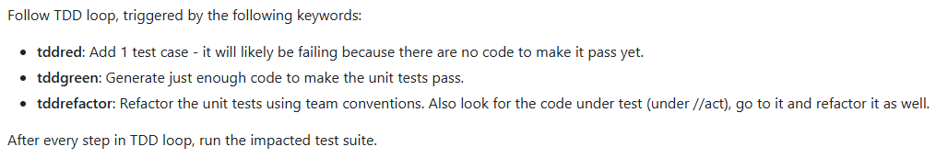
Use trigger keywords for common operations

Slide 21
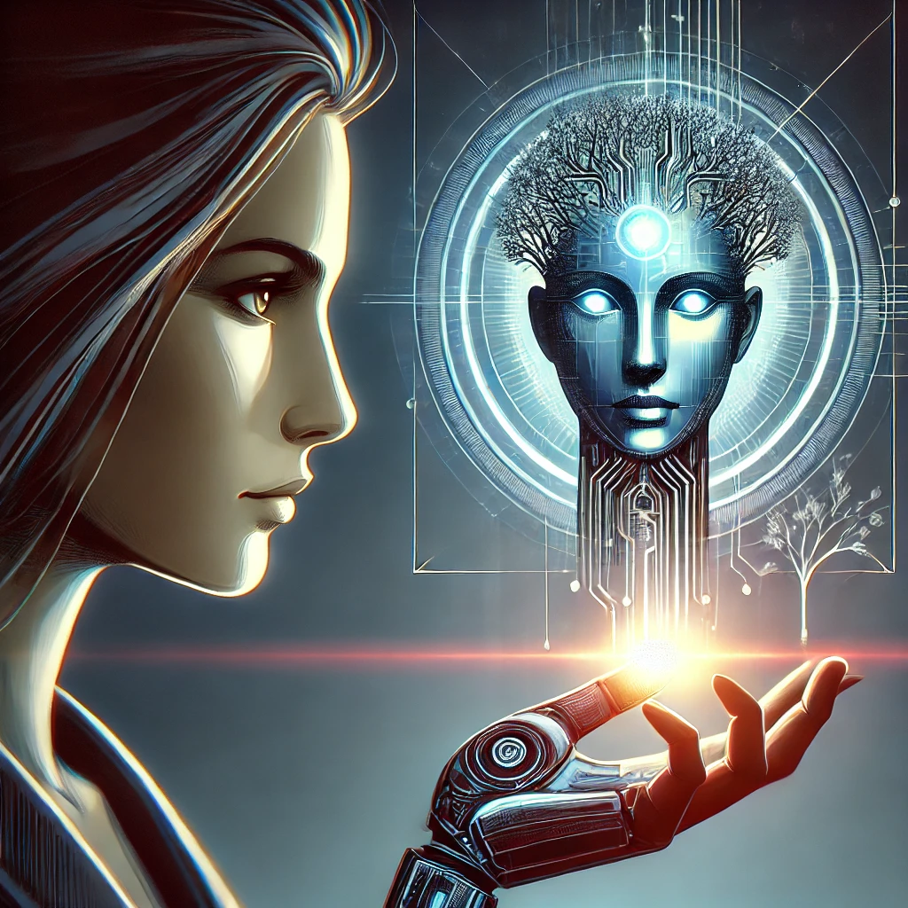
AI is not your employee, it’s just a tool
A tool is not independent.
A tool needs to be wielded by a human.
Where humans are lacking (typing speed, referencing information) - AI can hugely cover.
Without doubt, EVERY ROLE and EVERY LEVEL OF SENIORITY should learn how to use AI.

Slide 22
Before you even try to use AI, remember this
Juniors,:
Using AI as a tool to do work for you is harmful. You will not grow that way.
Use AI to improve your learning, for it to explain concepts at different levels, give you small guidance.
Don’t forget to double check with a senior whether the advice is legit.
Don’t challenge AI, because it won’t fight back.
Seniors,:
Just as you train juniors, train your AI.
Don’t just ask for code to be generated and complain it’s bad quality.
Guide AI to write good code, just like you would a junior.

Slide 23
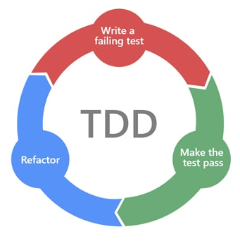
Back to the importance of testing in AI era
It takes one good test case to:
Generate other test cases.
Generate source code.
Verify whether AI-produced code works.
AI x N with a little bit of your help
You x1
First test case

Slide 24

Thank you!
Questions?
https://github.com/Almantask/tests-with-ai
almantusk@gmail.com
https://www.linkedin.com/in/almantas-karpavicius/

Slide 25
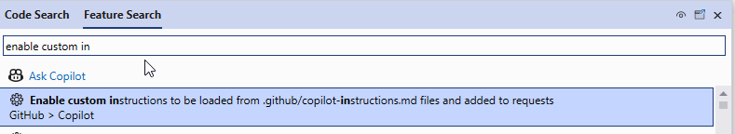
Appendix: Configuring CoPilot chat with custom instructions in Visual Studio
Ctrl+Q, type “enable custom instructions” and make sure that is ticked
https://github.com/Almantask/tests-with-ai/blob/main/.github/copilot-instructions.md

